Slide 1

ELECTRODE BASED BLOOD GAS SENSORS
Pranamya Jain 2018A8PS0769P Ayush Agrawal 2018A8PS0469P Nitin Pant 2018A8PS0381P

Slide 2
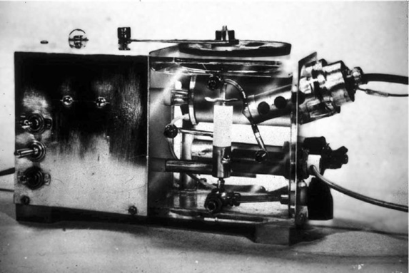

Slide 3
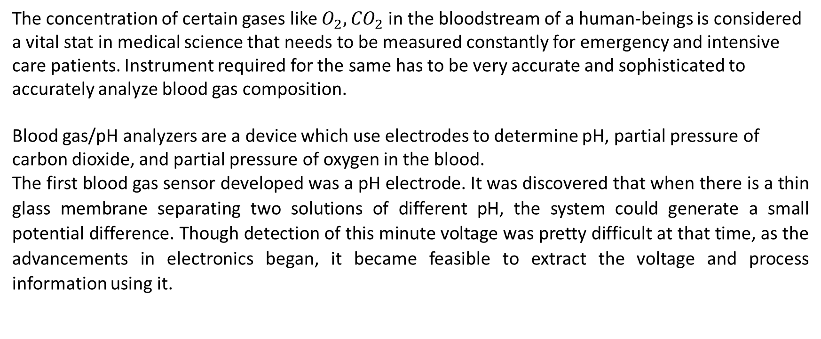
Electrode Based Blood Gas Sensors
The concentration of certain gases like $O_{2},{CO}_{2}$ in the bloodstream of a human-beings is considered a vital stat in medical science that needs to be measured constantly for emergency and intensive care patients. Instrument required for the same has to be very accurate and sophisticated to accurately analyze blood gas composition.
Blood gas/pH analyzers are a device which use electrodes to determine pH, partial pressure of carbon dioxide, and partial pressure of oxygen in the blood.
The first blood gas sensor developed was a pH electrode. It was discovered that when there is a thin glass membrane separating two solutions of different pH, the system could generate a small potential difference. Though detection of this minute voltage was pretty difficult at that time, as the advancements in electronics began, it became feasible to extract the voltage and process information using it.

Slide 4
Severinghaus Electrode
Used for measurement of CO₂
Developed by Dr. John W. Severinghaus and his technician A. Freeman Bradley
Consists of:
CO2-sensitive glass electrode in a surrounding film of bicarbonate solution
Covered by a thin plastic carbon dioxide permeable membrane
This membrane is impermeable to water and electrolytic solutes.

Slide 5
Severinghaus Electrode : Background concept and working principle
Background Concept:
CO2 cannot be reduced electrochemically in an aqueous solution.
But CO2 levels can be determined indirectly by dissolving it in an aqueous electrolyte solution and then monitoring the resulting change in pH.
Working principle:
The carbon dioxide pressure of a sample gas or liquid equilibrates through the membrane, and the glass electrode measures the resulting pH of the bicarbonate solution.
In the sensor electrolyte, a series of equilibrium reactions occur, resulting in the formation of H+ ions and thus in a CO2-dependent shift of the pH value, which is measured using the integrated pH electrode.

Slide 6
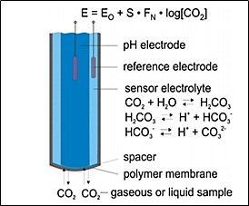
Severinghaus Electrode : Structure

Slide 7
Severinghaus Electrode : Structure
Primary structure consists of:
Thin polymer membrane,
The hydrogen carbonate containing electrolyte solution,
A thin hydrophilic spacer sheet soaked with the electrolyte solution,
A pH probe.
Typical materials used as sensor membranes are:
polytetrafluoroethylene (PTFE), polymethyl pentene (TPX), silicone and polypropylene (P.P.).
Their thicknesses range typically between 5 and 30 μm.
To improve the mechanical stability of these thin membranes :
They are mechanically protected
Or reinforced by a perforated metal foil or other embedded compounds.

Slide 8
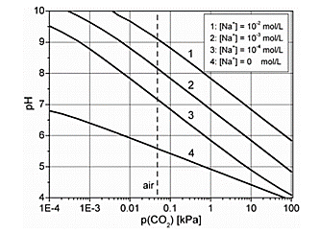
Severinghaus Electrode : Sensitivity
The sensitivity can be calculated as the slope of the graphs. Different graphs show variation with varying concentrations of NaHCo3 concentration in the sensor.

Slide 9
Severinghaus Electrode : Practical Considerations
The sensor used when exposed to ambient air results in drying out of electrolyte filling, this raises a problem of multiple and frequent recalibrations.
To prevent this, pH2O (vapors) is decreased to a certain extent by adding ethylene glycol.
This combined mixture does not influence the main sensor parameters significantly.
Apart from the mechanical, thermal, and electrical properties, the permeability for CO2 and H2O is essential for membrane material parameters.
The permeabilities do not influence equilibrium-type sensors' sensitivity, but long-term behavior and response time depend on them.

Slide 10

Severinghaus Electrode : Practical Considerations
The temperature dependence of the permeability P can be calculated from the activation energy Ea using the following equation: The ratio of the membrane permeabilities for H2O and CO2 is of special importance regarding equilibrium-type carbon dioxide sensors' long-term stability.
The ratio of the membrane permeabilities for H2O and CO2 is of special importance regarding equilibrium-type carbon dioxide sensors' long-term stability.
This parameter depends on the membrane material and amounts for silicone to p(H2O)/p(CO2) ≈ 13 and for polymethyl pentene to p(H2O)/p(CO2) < 1, which is therefore especially suited as membrane material for electrochemical CO2 gas sensors.

Slide 11
Severinghaus Electrode : Dynamic Response And Calibration
The sensor's response depends on various factors
Thickness and the material of GPM (effecting the transport of CO2 to the electrode),
Thickness of the electrolyte film
concentrations of bicarbonates, and carbonic acids, etc.
Calibration:
These sensors need to be calibrated very often to make the readings more accurate.
As CO2 based pH buffers solutions are not very stable, the buffer solution should be made just before starting the calibration process.
To avoid larger temperature-dependent errors, the calibration solution's temperature should deviate by no more than 5 K from that of the measuring solution.

Slide 12
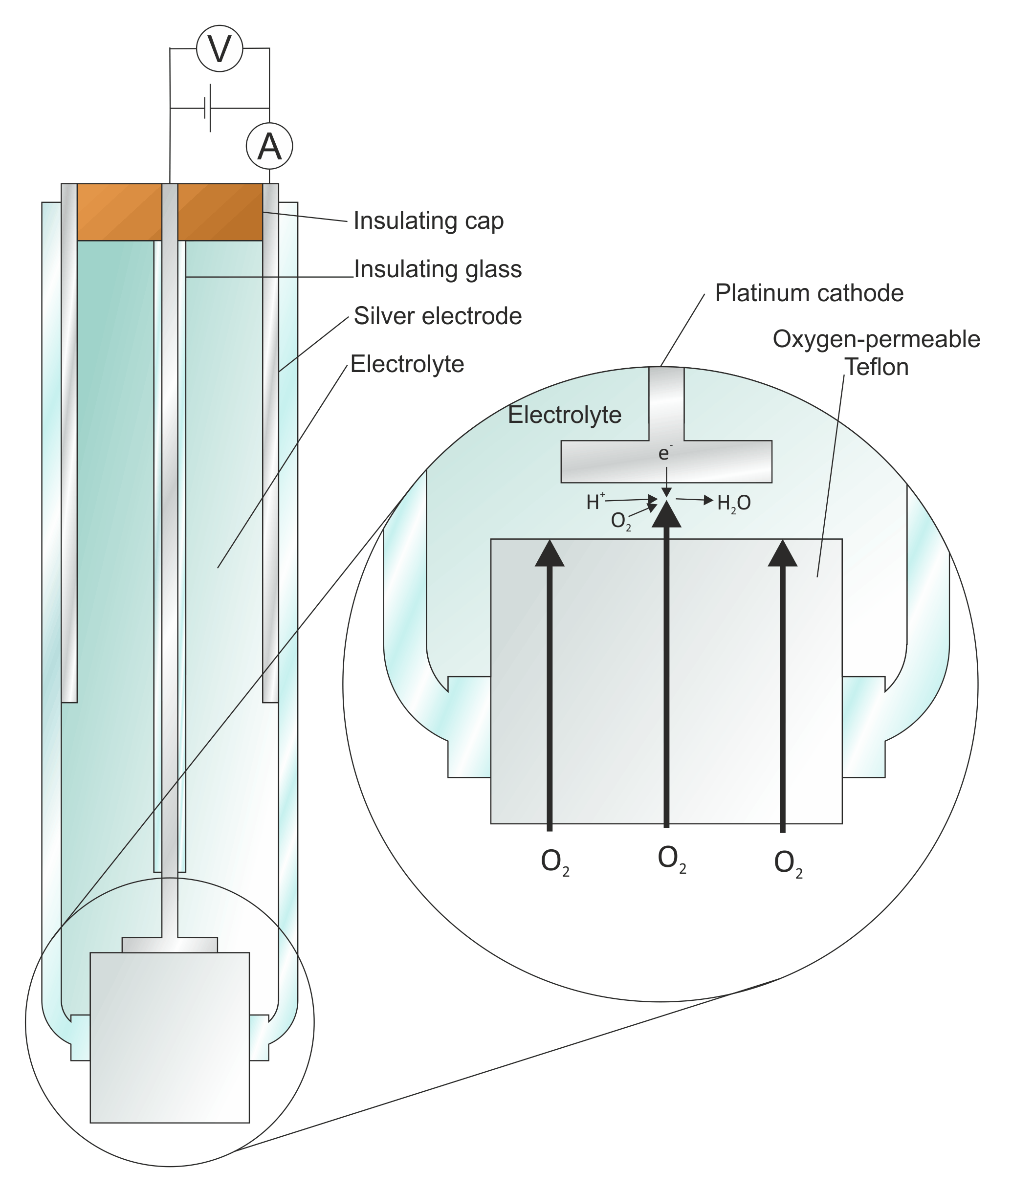
Clark’s Electrode : structure
Two electrode system namely Ag and Pt electrodes
Gas permeable membrane separating electrolyte from Oxygen sample (i.e. blood)
External electrical circuit consists of a variable voltage source and an ammeter
Material used for membrane are polypropylene, polyethylene , Teflon or Mylar

Slide 13
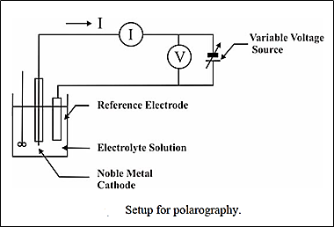
Clark’s Electrode : Working
External electrical circuit consists of a variable voltage source and an ammeter
Cathode is made negative w.r.t anode until the dissolved O2 molecules at cathode start getting reduced, resulting in flow of current in external circuit
Magnitude of current is proportional to conc. of O2 .
The rate of response of the electrode depends on the membrane thickness.

Slide 14
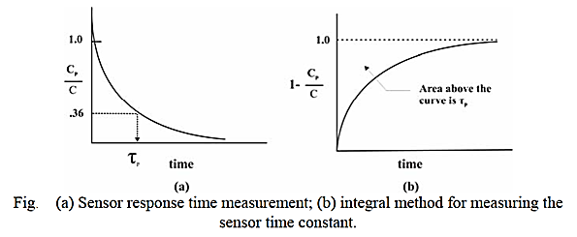
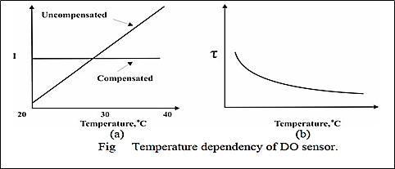
Clark’s Electrode :Dynamic Response and Temperature dependency

Slide 15
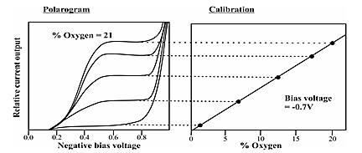
Clark’s Electrode : Calibration
In the beginning of the reduction process, current increases and as the time goes by it starts settling to a constant value
On further increasing the bias, the electrode's current output rises rapidly due to other reactions, primarily the reduction of water to hydrogen.
Relative current output vs % Oxygen yields linear characteristic curve for the voltage applied in the plateau region of the current close production vs Negative bias voltage

Slide 16
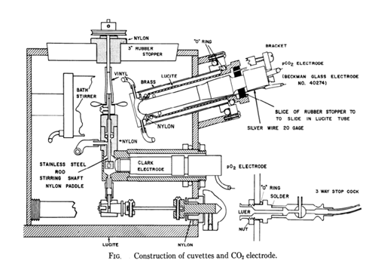
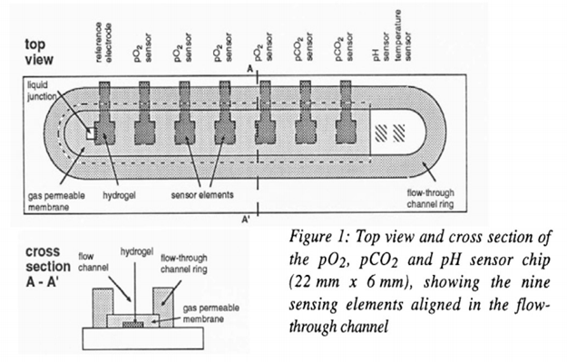
Combined Blood Sensor : Evolution

Slide 17
Combined Blood Sensor : Fabrication
Totally based on wafer level using IC-based technologies
Uses the basics of classical electrochemical sensing principles
The electrochemical cell is made using Ion-Sensitive Field Effect Transistors (ISFETs)
Sensing channel have an Internal volume of 15μl
total of 9 sensing elements comprising of :
4 amperometric pO2 sensors
2 ISFET-based pCO2,
1pH-ISFET sensor
1 temperature sensor
The Clark-type pO2 sensor has 9×8 small Pt-electrodes with 5μm in diameter spaced at 100μm. All are connected in parallel
Both Pt and Ag/AgCl electrodes are covered with lead and are separated from the sample using Gas Permeable Membrane.
The Severinghaus pCO2 sensor is made using pH-ISFET and Ag/AgCl reference electrode , covered with Hg and GPM.
pH sensor has the similar structure to that of pCO2 , but has a fissure in permeable membrane of 0.5μm×0.5μm dimension, which is used as the liquid junction.

Slide 18
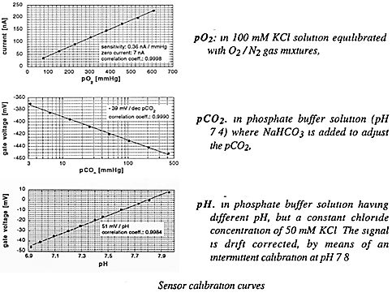
Combined Blood Sensor : Calibration
pO₂: in 100mM KCl solution equilibrated with O₂/N₂ gas mixtures
pCO₂: in phosphate buffer solution (pH), where NaHCO₃ is added to adjust the pCO₂
pH: in phosphate buffer solution having different (pH), but a constant chloride concentration of 50 mM KCl . The signal drift is corrected, by means of an intermittent calibration at pH 7-8

Slide 19
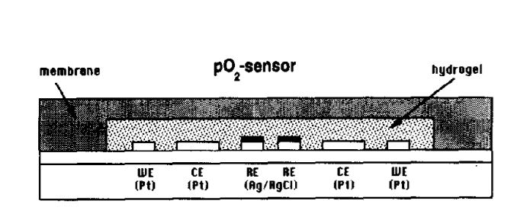
Combined Blood Sensors: Oxygen Sensor: Construction
This is a miniaturized amperometric Clark-type sensor with 3 thin film electrodes
WE- Working electrode - Platinum
RE – reference electrode – Ag layer covered with AgCl
CE- Counter electrode - Platinum
Electrodes arranged in a concentric arrangement
RE- centre- (0.125 mm²)
CE- around it- (1 mm²)
WE- outer ring-(0.5 mm²)
The polyacrylamide hydrogel layer:
Contains 100mM KCl and is made to cover the electrodes
Serves as an internal electrolyte
Separated from sample by outer gas permeable polysiloxane membrane

Slide 20
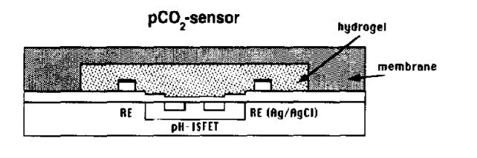
Combined Blood Sensors: CO₂ Sensor: Construction
Of Severinghaus type and uses an Al2O3-ISFET and a thin-film Ag/AgCl reference electrode (RE).
Both the ISFET and the RE are covered by a polyacrylamide hydrogel layer containing a 50 mM bicarbonate solution.
The hydrogel is separated from the sample by a polysiloxane membrane.
CO2 diffuses through the membrane into the hydrogel, and the resulting pH variation of the bicarbonate solution is detected by the ISFET.
Due to the hydration of CO2 and dissociation equilibrium of carbonic acid, there is a resulting pH change

Slide 21
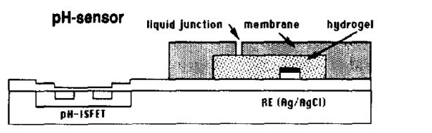
Combined Blood Sensors: pH Sensor: Construction
The pH of the sample is measured by an Al2O3- ISFET with a thin film Ag/AgCl reference electrode (RE).
The gate of the ISFET is in direct contact with the sample, while the RE is covered by a hydrogel layer containing a 100 mM KCl solution.
The hydrogel is separated from the sample by an outer polysiloxane membrane.
A small opening in this membrane serves as a liquid junction

Slide 22
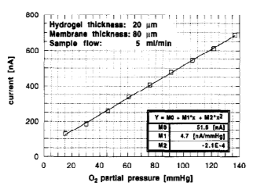
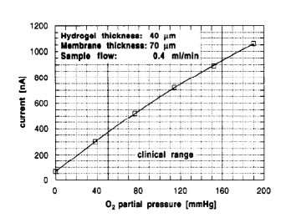
Combined Blood Sensors: Oxygen Sensor: Response
p02 sensitivity in a solution containing 5O mM NaHCO₃, 50 mM Na₂CO₃ and 1 mM KCL saturated with different 0₂/N₂ gas mixtures, sample flow: 5 ml/min, room temperature.
pO2 sensitivity in blood for transfusion at 37 °C saturated with different 02/N2 gas mixtures, sample flow: 0.4 ml/min.

Slide 23
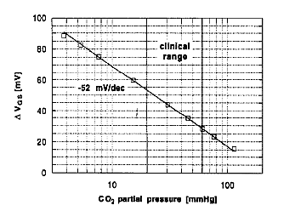
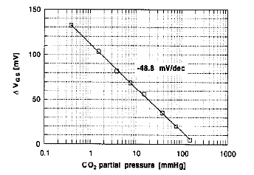
Combined Blood Sensors: CO₂ Sensor: Construction
pCO₂ sensitivity in a 100 mM KCL solution saturated with different C02/N2 gas mixtures; room temperature
pCO₂ sensitivity in blood for transfusion at 37 C saturated with different C02/N, gas mixtures, sample flow: 0.4 ml/min

Slide 24
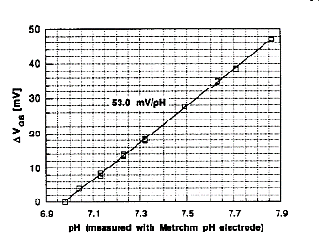
Combined Blood Sensors: pH Sensor: Response
pH sensitivity in different phosphate pH buffers containing 100 mM KCI, sample flow: 1 ml/min, room temperature.

Slide 25
Thank You

